Slide 1
Double & Circular Linked Lists
Prepared by: Afaq Mansoor Khan
BSSE III- Group A
Session 2017-21
IMSciences, Peshawar.

Slide 2
Last Lecture Summary
Insertion in Linked List with following criteria
Start of the list
End of the list
Middle of the list
Anywhere in the list
Deletion of a node from
The Tail of the List
The Head of the List
A desired location in the list
Delete node with a particular value

Slide 3
Objectives Overview
Introduction to Double Linked List
Insertions and Deletions in Doubly Linked List
Introduction to Circular Linked List
Insertion and Deletion in Circular Linked List

Slide 4
Doubly Linked List
In a doubly linked list, each node contains a data part and two addresses, one for the previous node and one for the next node.

Slide 5
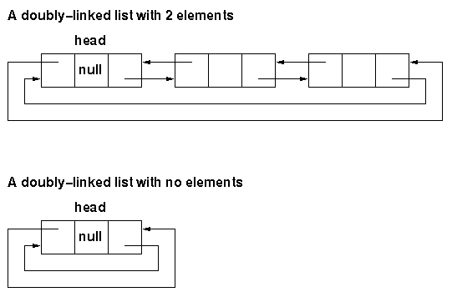
Doubly Linked List - Representation

Slide 6
Inserting into a Doubly Linked List

Slide 7
Inserting into a Doubly Linked List
A Node can be added in four ways: 1) At the front of the DLL 2) After a given node. 3) At the end of the DLL 4) Before a given node.

Slide 8
Insertion at the Front - Algorithm
Steps:
Allocate node
Put in the data
Make next of new node as head and previous as NULL
Change previous of head node to new node
Move the head to point to the new node

Slide 9
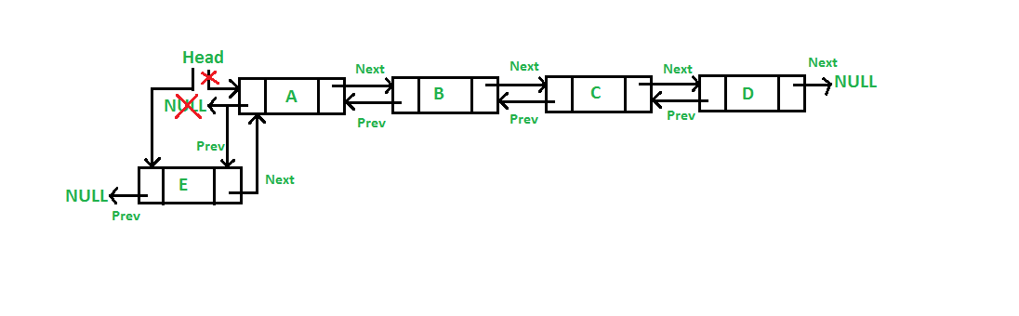
Insertion at the Front - Representation

Slide 10
Insertion at the Front - Implementation
void push(struct Node** head_ref, int new_data) {
struct Node* new_node = (struct Node*)malloc(sizeof(struct Node));
new_node->data = new_data;
new_node->next = (*head_ref);
new_node->prev = NULL;
if ((*head_ref) != NULL)
(*head_ref)->prev = new_node;
(*head_ref) = new_node;
}

Slide 11
Insertion after a given Node - Algorithm
Steps:
Check if the given previous node is NULL
Allocate new node
Put in the data
Make next of new node as next of previous node
Make the next of previous node as new node
Make previous node as previous of new node
Change previous of new node's next node

Slide 12
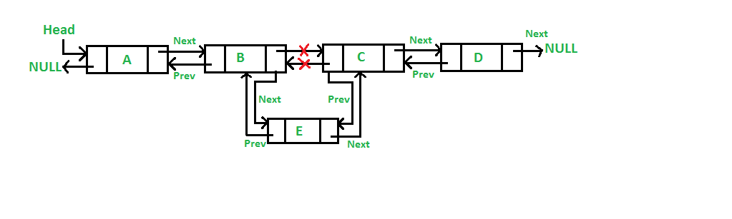
Insertion after a given Node - Representation

Slide 13
Insertion after a given Node - Implementation
void insertAfter(struct Node* prev_node, int new_data)
{
if (prev_node == NULL) {
printf("the given previous node cannot be NULL");
return;
}
struct Node* new_node = (struct Node*)malloc(sizeof(struct Node));
new_node->data = new_data;
new_node->next = prev_node->next;
prev_node->next = new_node;
new_node->prev = prev_node;
if (new_node->next != NULL)
new_node->next->prev = new_node;
}

Slide 14
Insertion at the End - Algorithm
Steps:
Allocate node
Put in the data
This new node is going to be the last node, so make next of it as NULL
If the Linked List is empty, then make the new node as head
Else traverse till the last node
Change the next of last node
Make last node as previous of new node

Slide 15
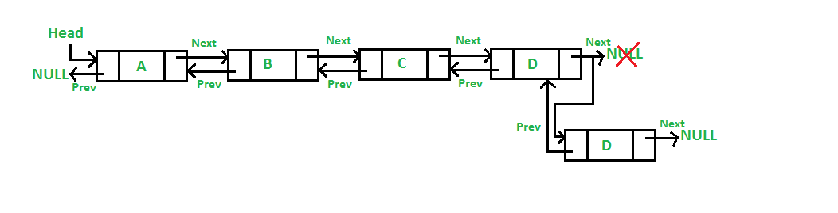
Insertion at the End - Representation

Slide 16
Insertion at the End - Implementation
void append(struct Node** head_ref, int new_data)
{
struct Node* new_node = (struct Node*)malloc(sizeof(struct Node));
struct Node* last = *head_ref; /* used in step 5*/
new_node->data = new_data;
new_node->next = NULL;
if (*head_ref == NULL) {
new_node->prev = NULL;
*head_ref = new_node;
return;
}
while (last->next != NULL)
last = last->next;
last->next = new_node;
new_node->prev = last;
return;
}

Slide 17
Insertion before a given Node - Algorithm
Steps:
Check if the given new node is NULL
Allocate new node
Put in the data
Make previous of new node as previous of next node
Make the previous of next node as new node
Make next node as next of new node
Change next of new node's previous node

Slide 18
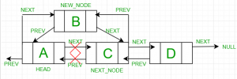
Insertion before a given Node - Representation

Slide 19
Insertion before a given Node - Implementation
void insertBefore(struct Node* next_node, int new_data)
{
if (next_node == NULL) {
printf("the given next node cannot be NULL");
return;
}
struct Node* new_node = (struct Node*)malloc(sizeof(struct Node));
new_node->data = new_data;
new_node->prev = next_node->prev;
next_node->prev = new_node;
new_node->next = next_node;
if (new_node->prev != NULL)
new_node->prev->next = new_node;
}

Slide 20
Deletion in Double Linked List

Slide 21
Algorithm
Let the node to be deleted is del. 1) If node to be deleted is head node, then change the head pointer to next current head. 2) Set next of previous to del, if previous to del exists. 3) Set prev of next to del, if next to del exists.

Slide 22
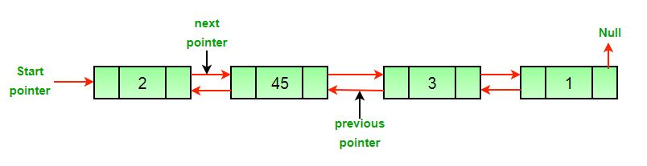
Original Doubly Linked List

Slide 23
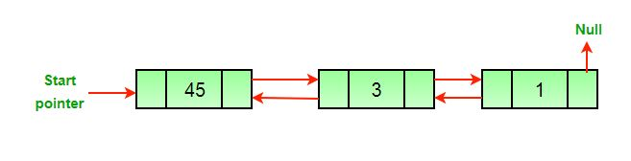
After deletion of head node

Slide 24
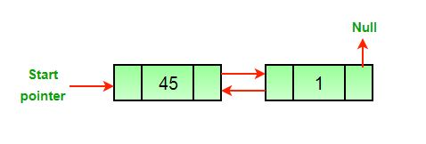
After deletion of middle node

Slide 25
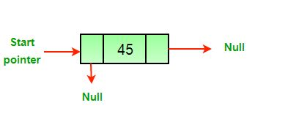
After deletion of last node

Slide 26
Advantages over Singly Linked List
1) A DLL can be traversed in both forward and backward direction. 2) The delete operation in DLL is more efficient if pointer to the node to be deleted is given. 3) We can quickly insert a new node before a given node. In singly linked list, to delete a node, pointer to the previous node is needed. To get this previous node, sometimes the list is traversed. In DLL, we can get the previous node using previous pointer.

Slide 27
Disadvantages over Singly Linked List
1) Every node of DLL Require extra space for an previous pointer. It is possible to implement DLL with single pointer though. 2) All operations require an extra pointer previous to be maintained. For example, in insertion, we need to modify previous pointers together with next pointers. For example in following functions for insertions at different positions, we need 1 or 2 extra steps to set previous pointer.

Slide 28
Circular Linked List

Slide 29
Circular Linked List
In circular linked list the last node of the list holds the address of the first node hence forming a circular chain.

Slide 30
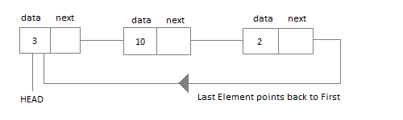
Circular Linked List - Representation

Slide 31
Inserting into a Circular Linked List

Slide 32
Insertion
A Node can be inserted in four ways:
Insertion in an empty list
Insertion at the beginning of the list
Insertion at the end of the list
Insertion in between the nodes

Slide 33
Insertion in an Empty List - Algorithm
Initially when the list is empty, last pointer will be NULL.
Insert a node T,
After insertion, T is the last node so pointer last points to node T.
Node T is first and last node, so T is pointing to itself.

Slide 34
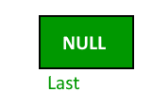
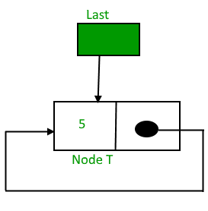
Insertion in an Empty List - Representation

Slide 35
Implementation
struct Node *addToEmpty(struct Node *last, int data)
{
// This function is only for empty list
if (last != NULL)
return last;
// Creating a node dynamically.
struct Node *last =
(struct Node*)malloc(sizeof(struct Node));
// Assigning the data.
last -> data = data;
// Note : list was empty. We link single node
// to itself.
last -> next = last;
return last;
}

Slide 36
Insertion at the Beginning - Algorithm
To Insert a node at the beginning of the list, follow these steps:
Create a node, say T.
Make T -> next = last -> next.
last -> next = T.

Slide 37
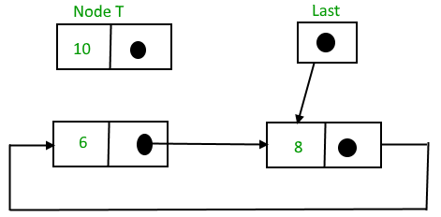
Insertion at the Beginning - Representation

Slide 38
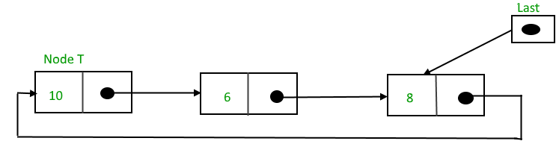
Insertion at the Beginning - Representation
After insertion

Slide 39
Implementation
struct Node *addBegin(struct Node *last, int data)
{
if (last == NULL)
return addToEmpty(last, data);
struct Node *temp = (struct Node *)malloc(sizeof(struct Node));
temp -> data = data;
// Adjusting the links.
temp -> next = last -> next;
last -> next = temp;
return last;
}

Slide 40
Insertion at the End - Algorithm
To Insert a node at the end of the list, follow these steps:
Create a node, say T.
Make T -> next = last -> next;
last -> next = T.
last = T.

Slide 41
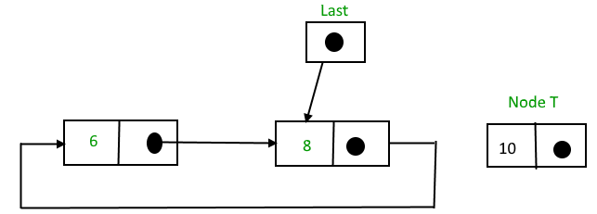
Insertion at the End - Representation

Slide 42
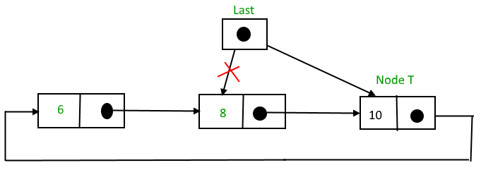
Insertion at the End - Representation
After insertion

Slide 43
Implementation
struct Node *addEnd(struct Node *last, int data)
{
if (last == NULL)
return addToEmpty(last, data);
struct Node *temp =
(struct Node *)malloc(sizeof(struct Node));
temp -> data = data;
temp -> next = last -> next;
last -> next = temp;
last = temp;
return last;
}

Slide 44
Insertion in between the Nodes - Algorithm
To Insert a node in between the Nodes, follow these steps:
Create a node, say T.
Search the node after which T need to be insert, say that node be P.
Make T -> next = P -> next;
P -> next = T.

Slide 45
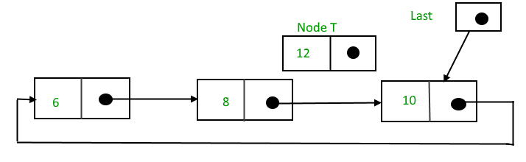
Insertion in between the Nodes - Representation

Slide 46
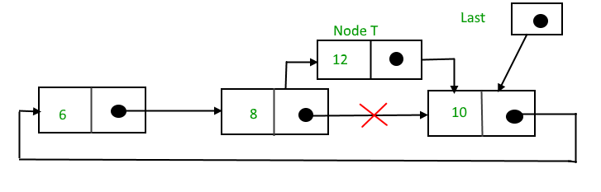
Insertion in between the Nodes - Representation
After searching and insertion

Slide 47
Implementation
struct Node *addAfter(struct Node *last, int data, int item)
{
if (last == NULL)
return NULL;
struct Node *temp, *p;
p = last -> next;
do
{
if (p ->data == item)
{
temp = (struct Node *)malloc(sizeof(struct Node));
temp -> data = data;
temp -> next = p -> next;
p -> next = temp;
if (p == last)
last = temp;
return last;
}
p = p -> next;
} while (p != last -> next);
cout << item << " not present in the list." << endl;
return last;
}

Slide 48
Deletion in Circular Linked List

Slide 49
Deletion in Circular Linked List
There are three situation for Deleting element in list.
Deletion at beginning.
Deletion at the middle.
Deletion at the end.

Slide 50
Deletion - Algorithm
Steps:
Create a circular linked list and assign reference of first node to head.
Input key to delete from user. Store it in some variable say key. Say key to delete is 20.
To keep track of previous node and node to delete, declare two variables of node type. Say cur = head and prev. Make sure previous points to last node.
If current node contains key, Then you got node to delete.
Before deleting a node, you must first adjust previous node link.
Adjust head node if needed.
Delete the node.
Update current node, i.e. assign cur = previous->next if previous != NULL. Otherwise assign NULL.
If current node does not contain key to delete, then simply update previous and current node.
Repeat step 3-4 till last node.

Slide 51
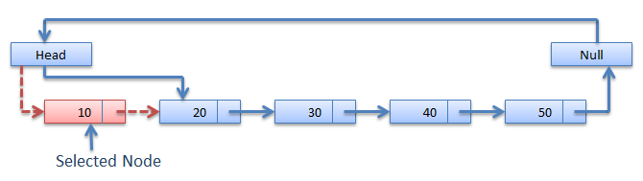
Representation
Deletion at the middle of the Circular linked list

Slide 52
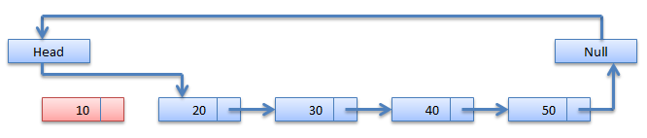
Representation
After Deletion

Slide 53
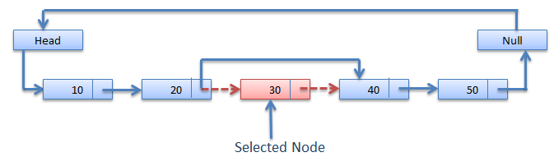
Representation
Deletion at the middle of the Circular linked list

Slide 54
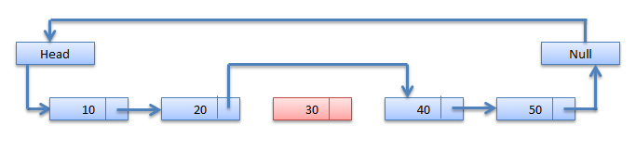
Representation
After Deletion

Slide 55
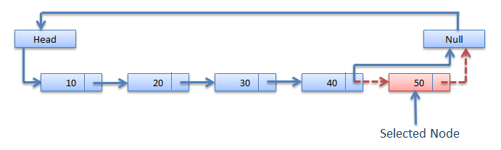
Representation
Deletion at the End of the Circular linked list

Slide 56
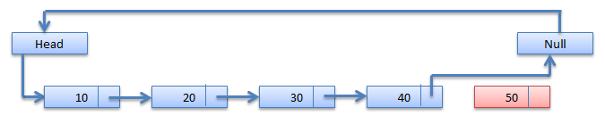
Representation
After Deletion

Slide 57
Implementation
void delete_first(struct link *node) {
node=start->next;
ptr=start;
if(i==0) {
printf("\n List is empty");
exit(0);
}
ptr->next=node->next;
free(node);
i--;
}

Slide 58
Summary
Introduction to Double Linked List
Insertions and Deletions in Doubly Linked List
Introduction to Circular Linked List
Insertion and Deletion in Circular Linked List

Slide 59
References
https://www.geeksforgeeks.org/doubly-linked-list/
http://scanftree.com/Data_Structure/Deletion-in-circular-linked-list
https://www.tutorialspoint.com/data_structures_algorithms/circular_linked_list_algorithm.htm
https://codeforwin.org/2018/06/c-program-to-delete-element-from-circular-linked-list.html
https://www.cse.unr.edu/~bebis/CS308/PowerPoint/LinkedDoublyLists.ppt

